Slide 1
Azure Security Posture

Slide 2
Agenda
A Modern Enterprise
Challenges Faced
Need for Azure Governance
The Governance Scaffolding
Understand the Security Landscape
Components of Azure Security Model
Unified Security Management - Azure Security Center
Unified Visibility
Advanced Threat Prevention
Intelligent Detection & Response
Security Implementation Process

Slide 3
Adaptive Threat Prevention
Azure Security Center

Slide 4
Detect cyber threats
Continuously analyzes security data from your Azure virtual machines, Azure services (like Azure SQL databases), the network, and connected partner solutions
Leverages security intelligence and advanced analytics to detect threats more quickly and reduce false positives
Creates prioritized security alerts that provide insight into the attack and recommendations on how to remediate

Slide 5
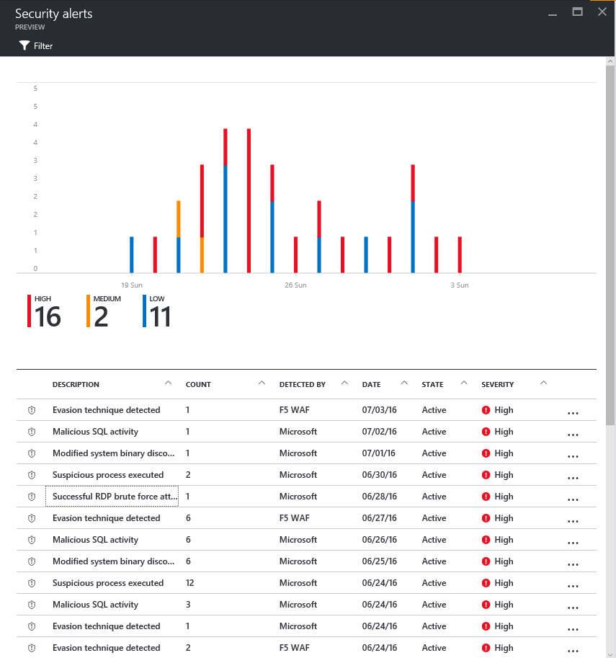
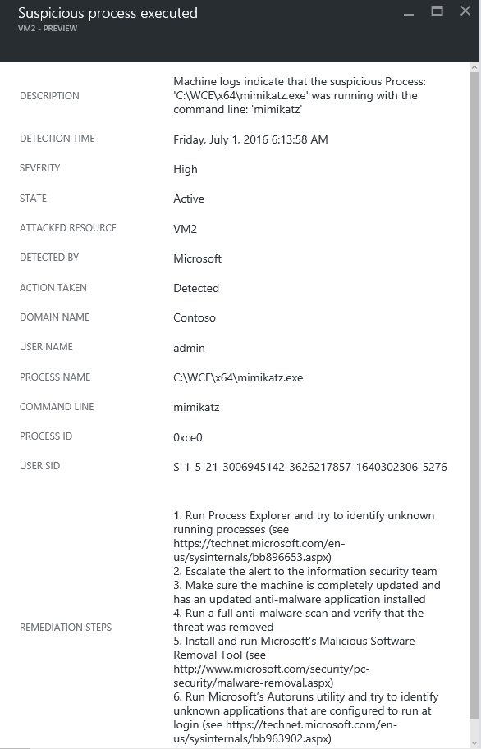
Prioritized security alerts provide details about the threat detected and suggests steps to remediate

Slide 6
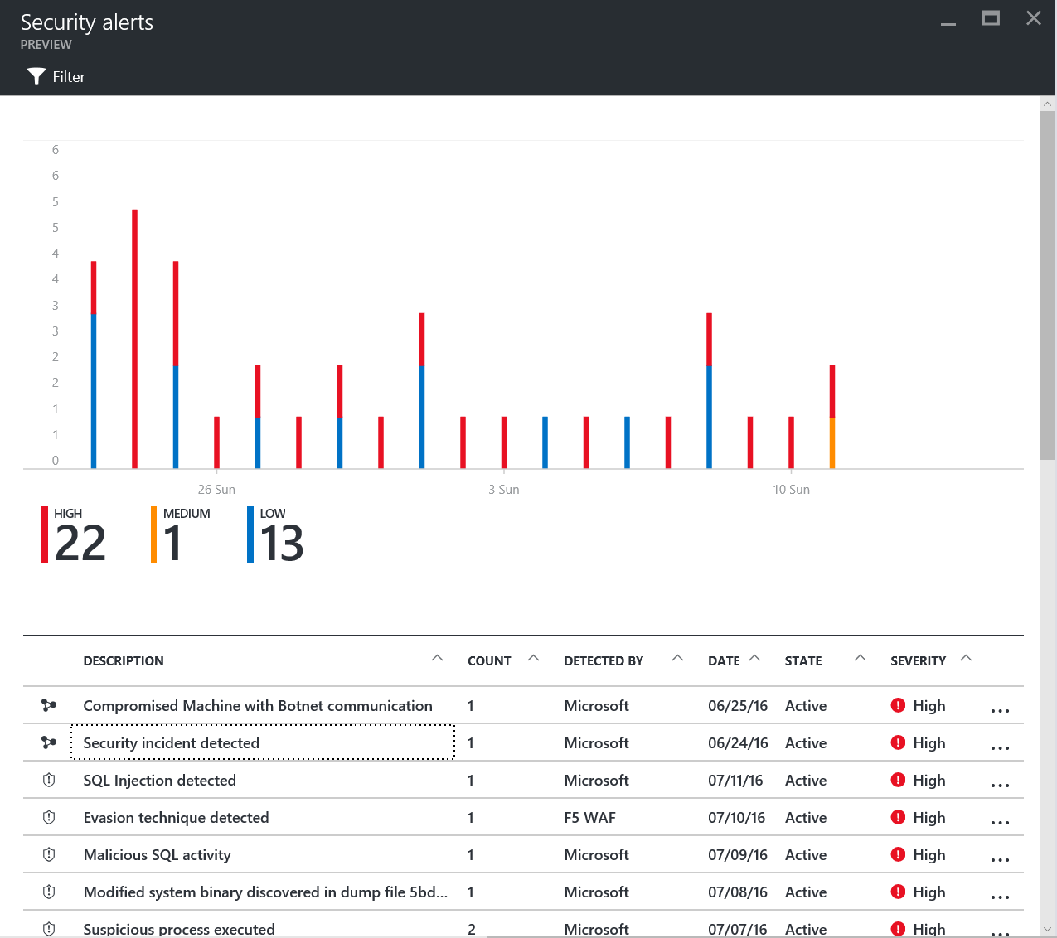
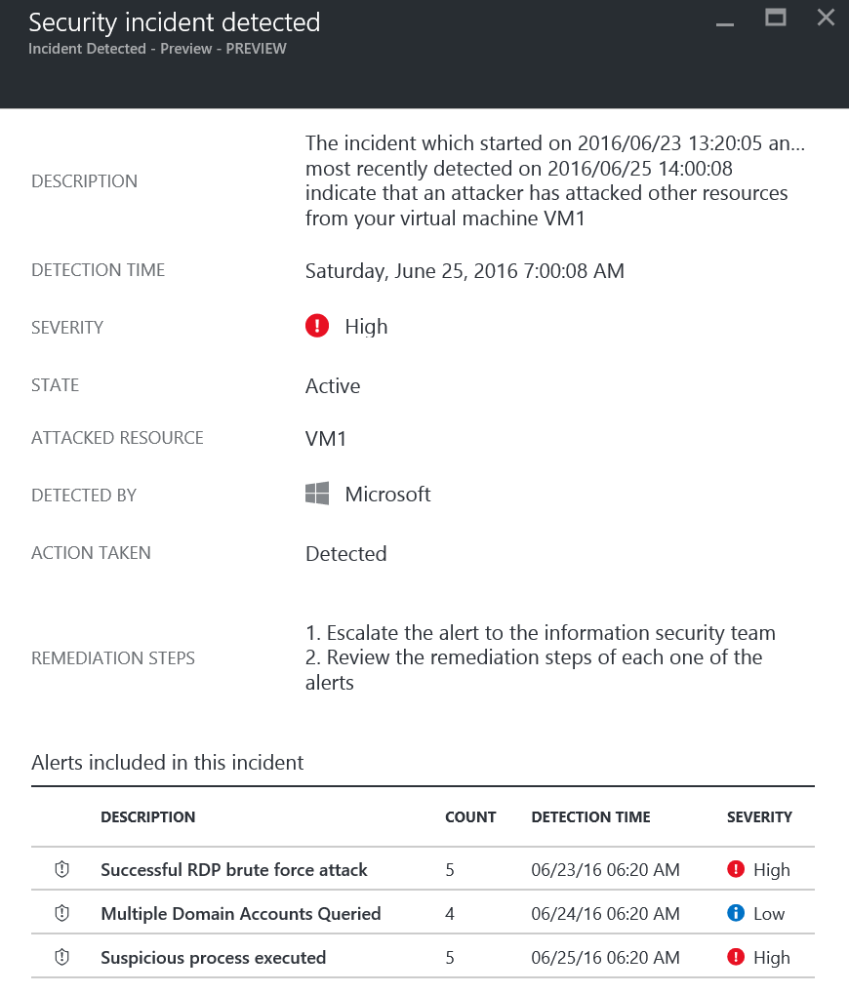
Alerts that conform to kill chain patterns are fused into a single incident

Slide 7
Advanced detection capabilities
Threat intelligence
Looks for known malicious actors
Examples
Network traffic to malicious IP address
Malicious process executed
Behavioral analytics
Looks for known patterns and malicious behaviors
Examples
Process executed in a suspicious manner
VM started sending spam email
Anomaly detection
Uses statistical profiling to build historical baselines
Alert on deviations that conform to a potential attack vector
Example
Remote desktop connections to a specific VM typically occur 5 times a day, today there were 100 connection attempts
Fusion
Combine events and alerts from across the kill chain to map the attack timeline
Examples
SQL injections (WAF + Azure SQL Logs)
Malicious process (Crash dump… and later… suspicious process execution)
Breach detection (Brute force attempt… and later… suspicious VM activity)

Slide 8
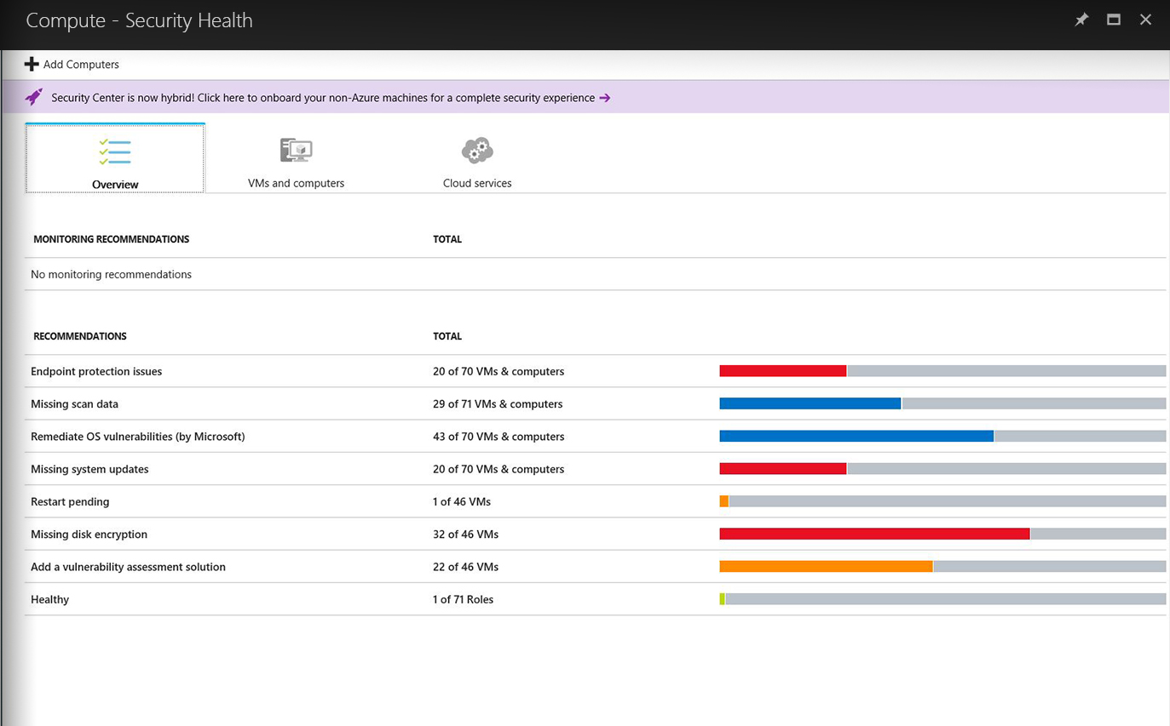
Identify and remediate vulnerabilities quickly
Continuous assessment of machines, networks, and Azure services
Hundreds of built-in security assessments, or create your own
Fix vulnerabilities quickly
Prioritized, actionable security recommendations

Slide 9
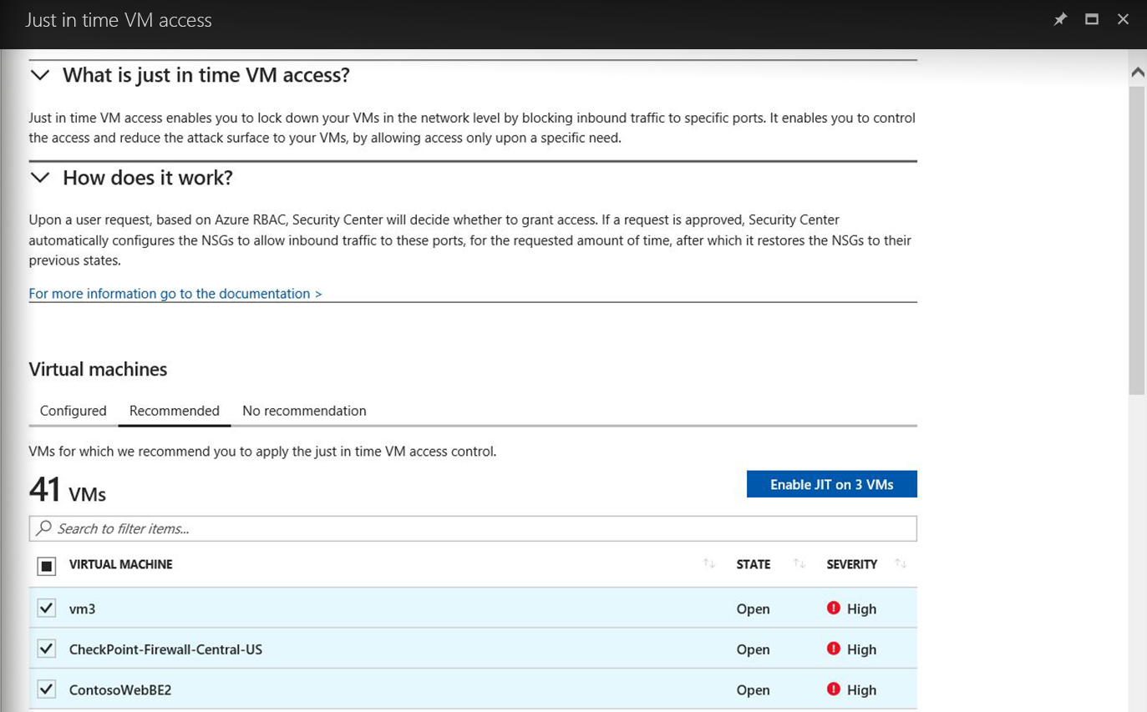
Limit exposure to brute- force attacks
Lock down ports on virtual machines
Enable just-in-time access to virtual machines
Access automatically granted for limited time

Slide 10
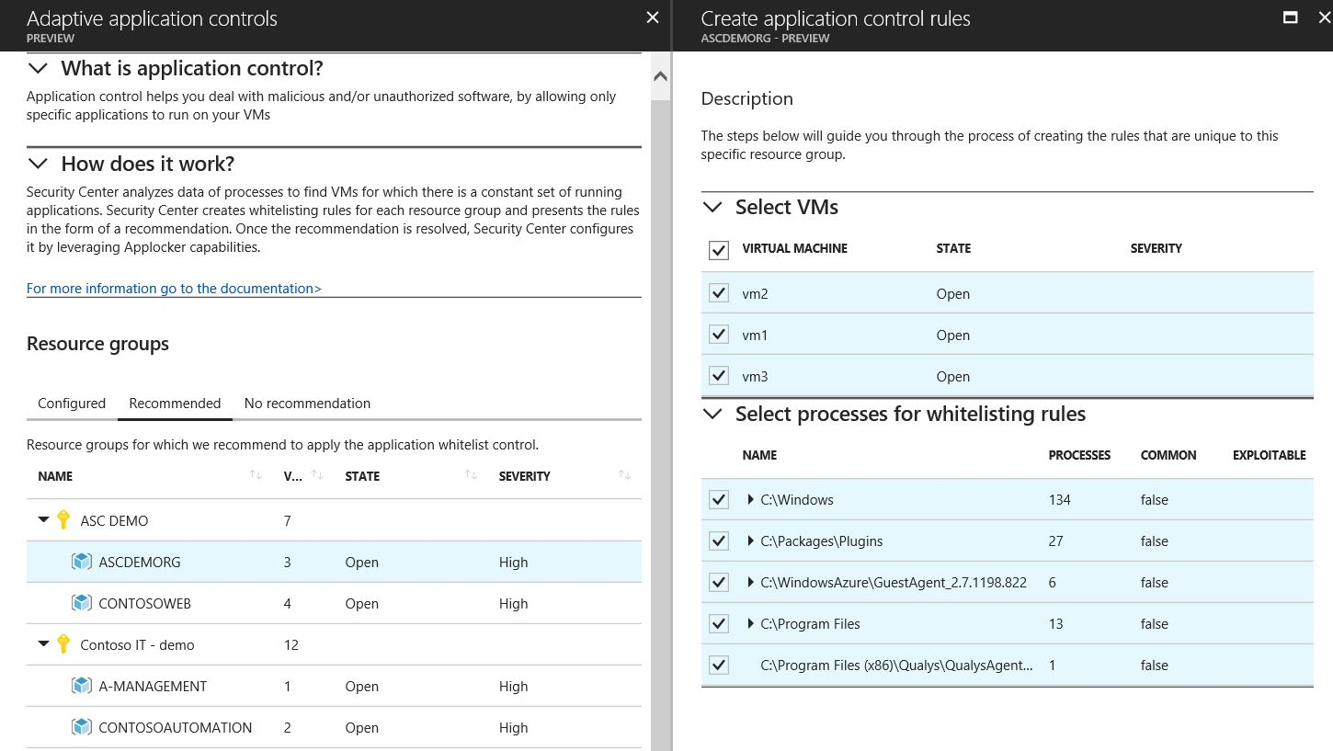
Block malware and other unwanted applications
Allow safe applications only
Adaptive whitelisting learns application patterns
Simplified management with recommended whitelists

Slide 11
Intelligent Detection & Response
Azure Security Center

Slide 12
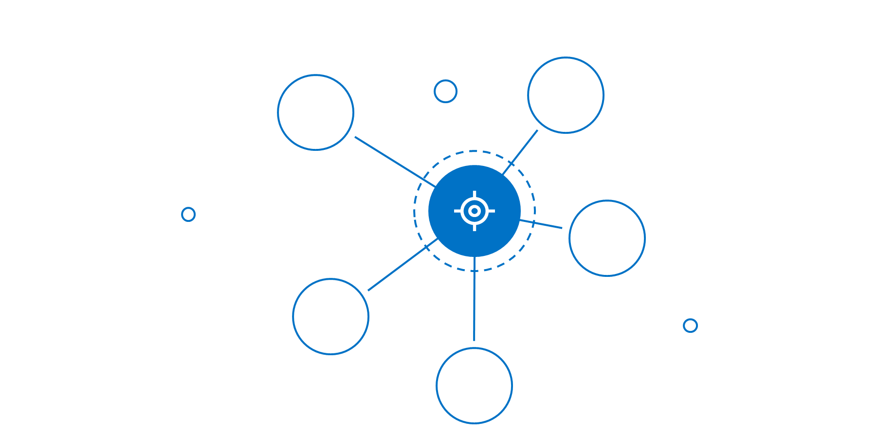
Built-in intelligence and advanced analytics
Powered by Microsoft Intelligent Security Graph

Slide 13
Detect threats across the kill chain
Target and attack
Install and exploit
Post breach
Inbound brute-force RDP, SSH, SQL attacks and more
Application and DDoS attacks (WAF partners)
Intrusion detection (NG Firewall partners)
In-memory malware and exploit attempts
Suspicious process execution
Lateral movement
Internal reconnaissance
Communication to a known malicious IP (data exfiltration or command and control)
Using compromised resources to mount additional attacks (outbound port scanning, brute-force RDP/SSH attacks, DDoS, and spam)

Slide 14
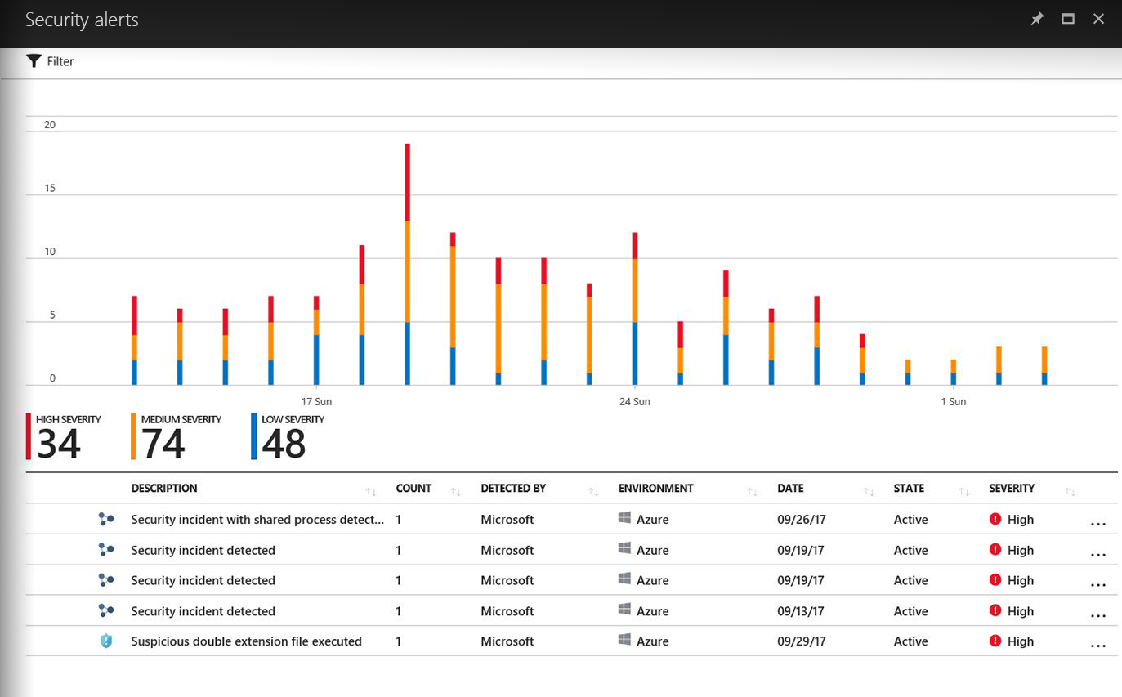
Focus on the most critical threats
Get prioritized security alerts
Details about detected threats and recommendations
Detect threats across the kill chain
Alerts that conform to kill chain patterns are fused into a single incident

Slide 15
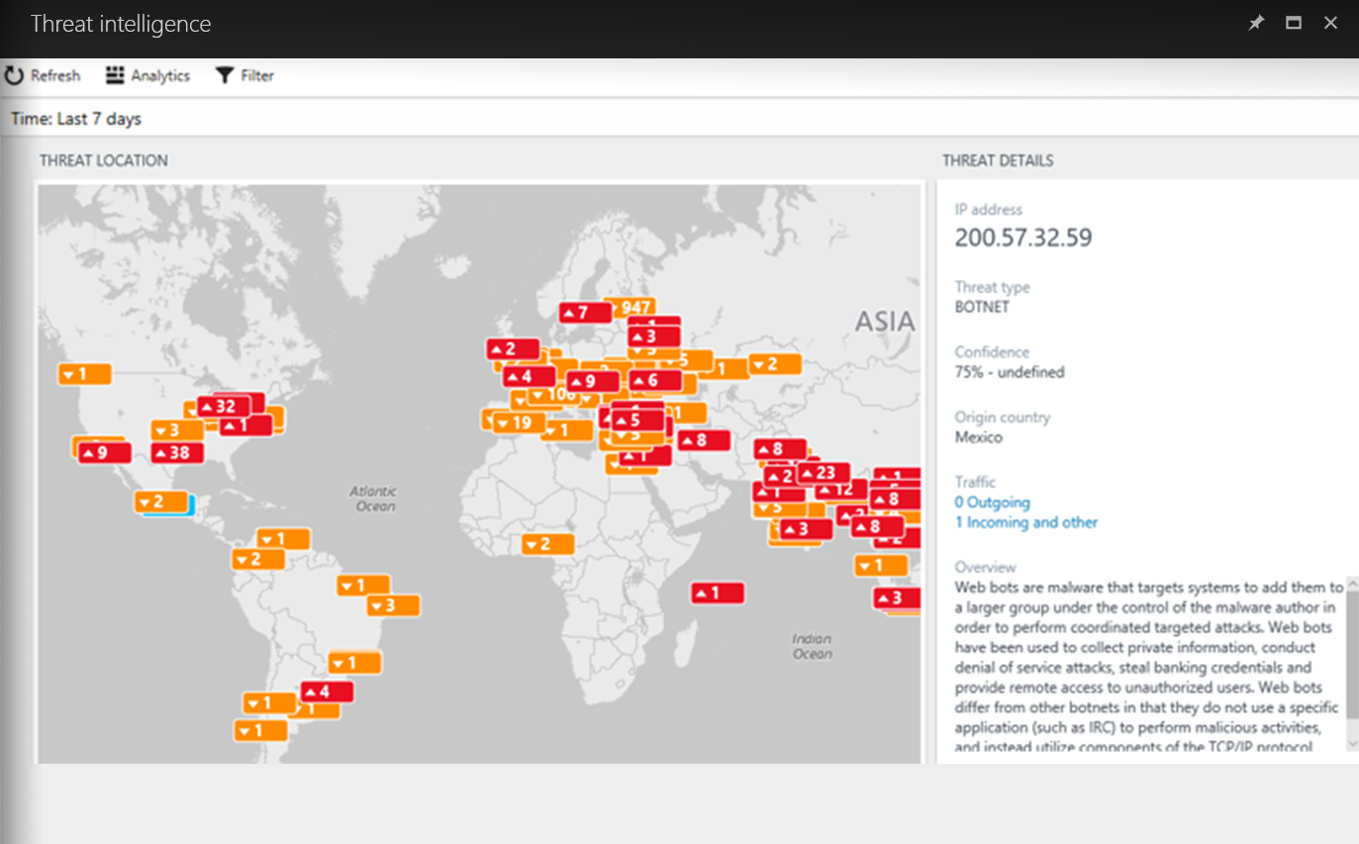
Gain valuable insights about attackers
Visualize source of attacks with interactive map
Analyzes data from your computers and firewalls logs
Gain insights through threat reports
Attacker’s known objectives, tactics, and techniques

Slide 16
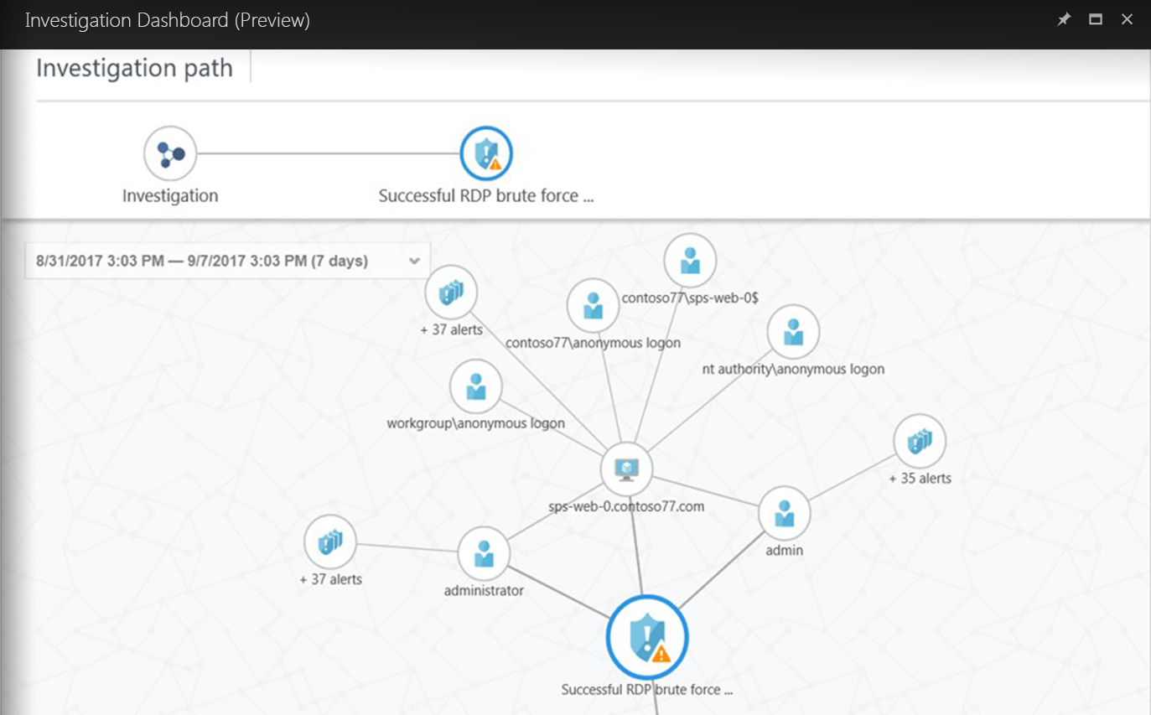
Simplify security operations and investigation
Quickly assess the scope and impact of an attack
Interactive experience to explore links across alerts, computers and users
Use predefined or ad hoc queries for deeper examination

Slide 17
Respond quickly to threats
Automate and orchestrate common security workflows
Create playbooks with integration of Azure Logic Apps
Trigger workflows from any alert to enable conditional actions
Common workflows
Route alerts to a ticketing system
Gather additional information
Apply additional security controls
Ask a user to validate an action
Block a suspicious user account
Restrict traffic from an IP address

